Slide 1
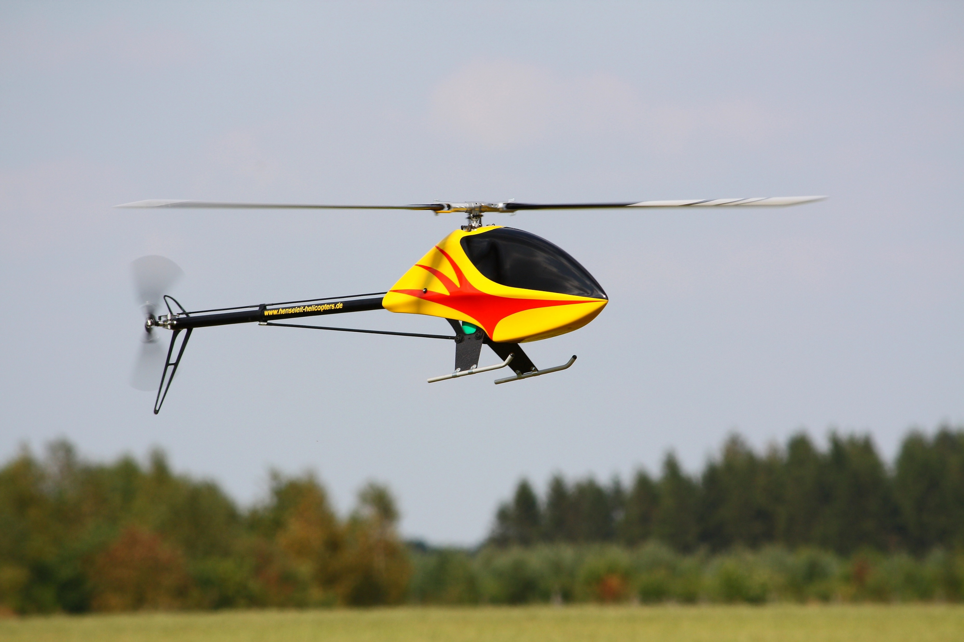
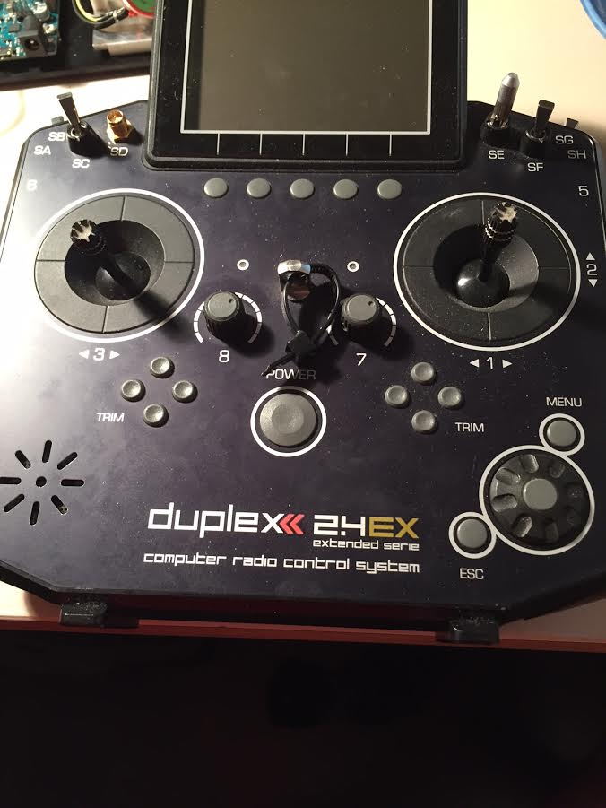

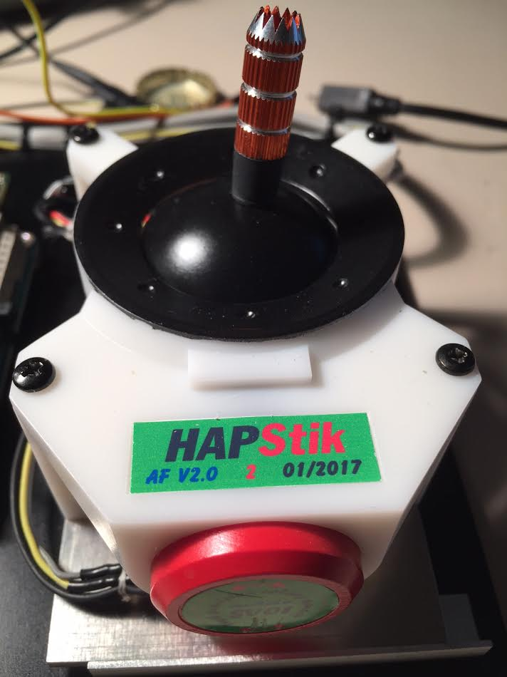
Trainee Mode: „Feel realtime“
Real model
Instructor Tx Radio
Tx Module
(zb Jetibox Profi)
radio
radio
Capture Signal
Instructor controls
model
PPM
out
Control HAPStik
Simulator model
Trainee HAPStik
Sim Input

Slide 2
Trainee Mode: „Feel and control realtime“
Real model
Instructor Tx Radio
Tx Module
(zb Jetibox Profi)
radio
radio
Capture Signal
HAPStik (Trainee) controls
PPM
out
Control HAPStik
Simulator
Trainee HAPStik
Sim Input

Slide 3

Trainee Mode: „Feel playback (only sim)“
Playback recorded Signal
playback controls
model
PPM
out
Control HAPStik
Simulator model
Trainee HAPStik
Sim Input

Slide 4
Trainee Mode: „Feel & control playback“
Real model
Tx Module
(zb Jetibox Profi)
radio
Playback recorded Signal
HAPStik (Trainee) controls
PPM
out
Control HAPStik
Simulator
Trainee HAPStik
Sim Input

